Slide 1
RPI Campus Map
By: Sebastien Boulas, Justin Gaskins, Christopher Pence

Slide 2
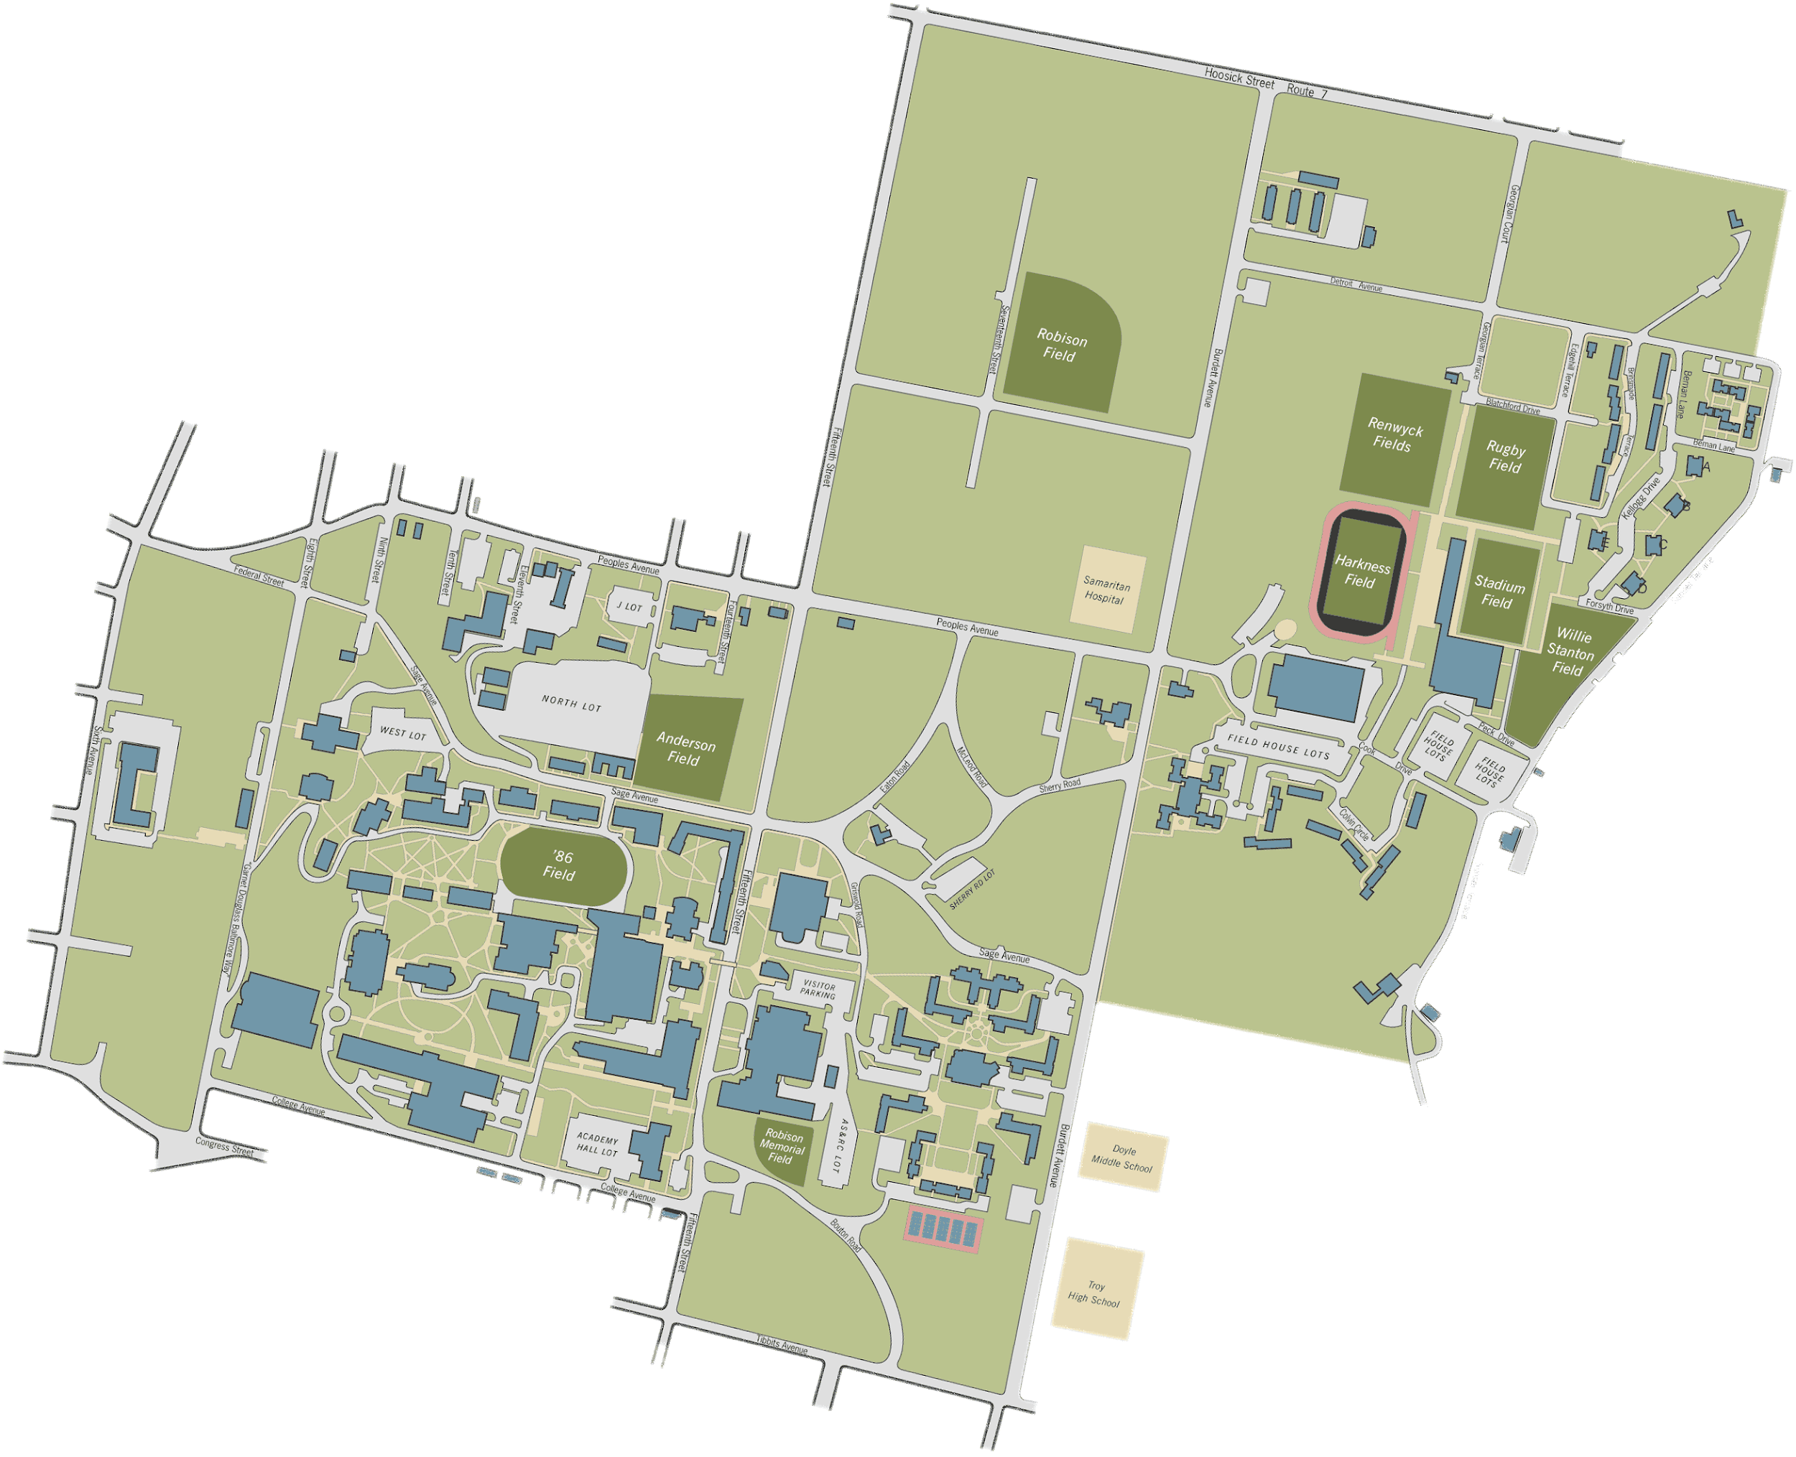
The Problem We are Solving
Current campus maps are static and difficult to follow
Notes:
Ultimately the problem that our project will be solving is the fact that current maps are static and difficult to follow as you can see with the map that I have included as an example. It can be difficult for visitors or incoming freshman on campus to really know how to get around without a prior understanding or where surrounding buildings are.

Slide 3
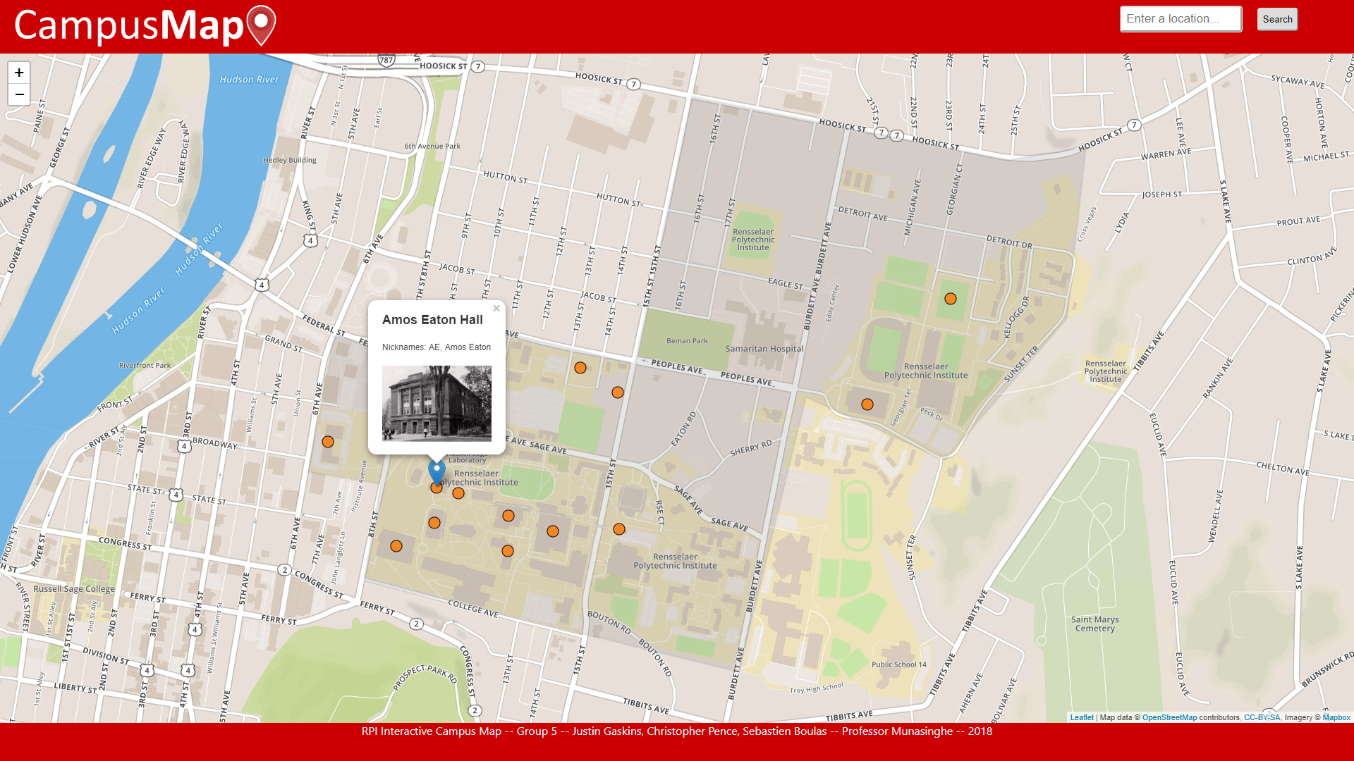
Introduction to Product
Interactive campus map
Database include information about each location on campus
Includes photos of different locations on campus
Helpful comments about various locations posted
Notes:
Our interactive campus map will allow users to click on specific locations on a map. Then we will have a database that has information about each location on campus. When a location is clicked on,

Slide 4

Target Users
Target market would be new students, freshman, and visitors on campus
Anyone can view the campus map along with the reviews
Current students posting photos and reviews

Slide 5





Technologies Used
Javascript
PHP
mySQL/phpMyadmin
Apache Web Server
HTML/CSS
JSON
Leaflet Map API

Slide 6
Major Feature A
Interactive Map
When a user clicks on a specific map location, an image and the location’s name is shown
Map can be moved or panned in or out for a better view
Support for multiple tile layers and dynamic loading of markers

Slide 7

Major Feature B
Searching
Search bar on the top of each page allows user to search for:
Official names of locations
Nicknames for locations

Slide 8

Major Feature C
Comments and Images
Using a database we store user comments
We allow users to submit comments
Users can submit links to images
Notes:
All buildings located on RPI’s campus will be available in our database.

Slide 9
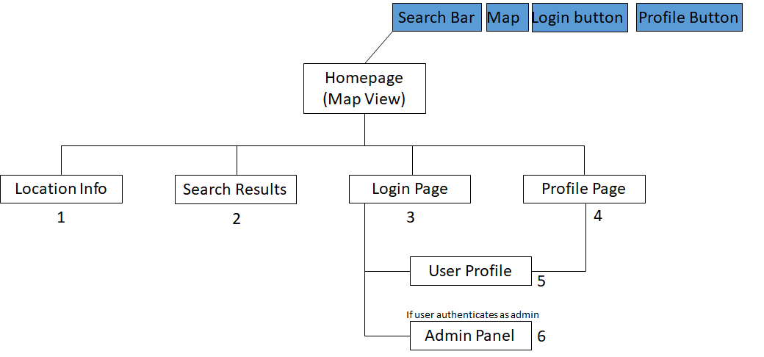
Architectural Overview
PHP
SQL
Leaflet Javascript
HTML/CSS

Slide 10
Demonstration

Slide 11
Dates | Project Deliverables
September 18, 2018 | Term project proposal
October 5, 2018 | Project proposal resubmission
November 1, 2018 | All pictures collected for project
November 15, 2018 | HTML/CSS outline completed
November 25, 2018 | Database outline completed
November 29, 2018 | PHP code completed
December 2, 2018 | Javascript code added along with additional HTML/CSS features
December 3, 2018 | Final presentation completed
December 11, 2018 | Final touches to code and team evaluations completed

Slide 12
Contributions Made
Sebastien Boulas
Presentation, project proposal, database outline
Javascript code
Justin Gaskins
HTML /CSS styling
Map Javascript
Christopher Pence
PHP code
Completed database

Slide 13
Lessons Learned
Non-technical
Always have a plan B
Losing a team member required our team to adjust
Technical
API
Using PHP to search and insert into an SQL database
Notes:
Non -Technical
It is important to determine at the beginning when creating the project outline to make sure that we identify what the most important areas for functionality are and what some of the added features would be.
If something happens with a group member, you can always trim down some of the added features for the project. At least in the short term

